Slide 1


The Lighthouse at Alexandria
Written by Lin Donn
Illustrated by Phillip Martin

Slide 2

The
Lighthouse at Alexandria

Slide 3
The Seven Wonders
Selected by the Ancient Greeks
When the ancient Greeks decided to select seven wonders from the many impressive structures that had been constructed throughout history, there was a lot of argument about which structures to select.
Over the years, many different lists were created. Finally, a list was presented that most Greeks agreed included the seven most wondrous wonders, each a unique achievement.

Slide 4
The Lighthouse at Alexandria
Nearly everyone agreed that the Lighthouse should be included as one of the wonders of the world.
It was built around 290 BCE on the Island of Pharos in the harbor of Alexandria, Egypt.

Slide 5
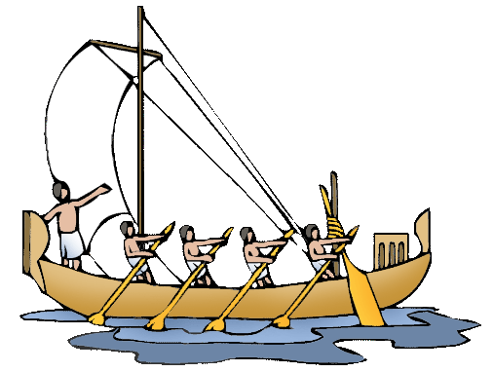
The Lighthouse at Alexandria
It was a working lighthouse that helped ships find their way safely into harbor.
It was also a tourist attraction.

Slide 6
The Lighthouse at Alexandria
In ancient times, visitors could buy food at the observation platform on the first level.
Anyone who wished to do could climb nearly to the top.
There were not many places in the ancient world that visitors could climb a man-made structure, 300 feet up, to view the sea.

Slide 7
The Lighthouse at Alexandria
The Lighthouse at Alexandria stood for over 1500 years.
Scientists believe an earthquake topped the Lighthouse during the 12th century CE, about 250 years before Columbus discovered America!
Divers today search for remains of the Lighthouse at the bottom of the Mediterranean Sea.

Slide 8
The Lighthouse at Alexandria
To learn more, see these sites:
Pharos Lighthouse
Games & Activities

Slide 9
Visit the Seven Wonders of the Ancient World
Great Pyramid at Giza
Hanging Gardens of Babylon
Statue of Zeus at Olympia
Temple of Artemis at Ephesus
Mausoleum at Halicarnassus
Colossus of Rhodes
Lighthouse at Alexandria

Slide 10
Help yourself to FREE Clip Art & Templates
Free Seven Wonders Clip Art
Free Templates

Slide 11

Explore …
PPPST.COM

